Slide 1
Centralized MPC for Autonomous Intersection Crossing
Lea Riegger, Markus Carlander, Niklas Lidander,
Nikolce Murgovski, Jonas Sjöberg
Department of Signals and Systems,
Chalmers University of Technology
Gothenburg, Sweden

Slide 2
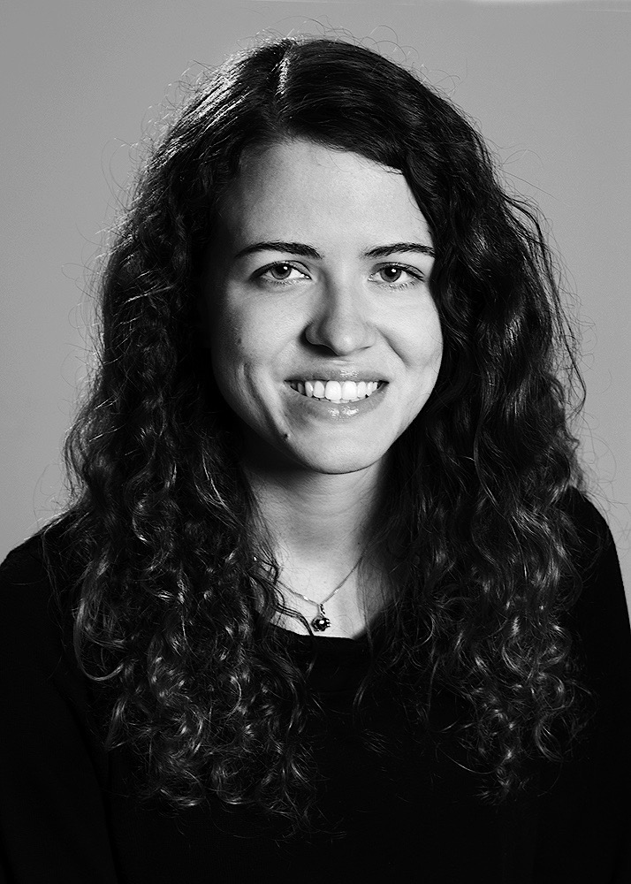
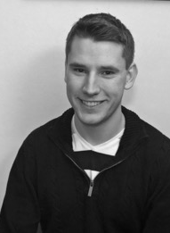

Lea Riegger
Markus Carlander
Niklas Lidander
M.Sc. Engineering Cybernetics
M.Sc. Systems, Control and Mechatonics
M.Sc. Systems, Control and Mechatonics
M.Sc. Systems, Control and Mechatonics

Slide 3
Problem statement: intersection crossing
Optimal control for safe and autonomous crossing
Path and reference speed of each vehicle are known
Centralized Model Predictive Controller (MPC)
Control of all vehicles in the control region of the intersection
Optimized trajectories
Only one vehicle at a time in the critical region
Notes:
Blue lines: start and end of the control region
Yellow region: enlarged set (explained later)
Crossing sequence: order in which the vehicles cross the intersection, in the following fixed, the optimal sequence can be found by evaluating all possible sequences

Slide 4
Convex optimization problem
State vector
Linear state space model for each vehicle i:
Notes:
Vehicle dynamics: point mass in control model
Formulate it in a convex form→ space coordinates
Spatial coordinate p
Vehicle velocity v_i
Time needed to reach position p: t_i

Slide 5
Convex optimization problem
Cost function:
Cost for each vehicle i:
Penalize deviation from reference velocity
Penalize high longitudinal acceleration and jerk
Notes:
The cumulative cost function is the sum of cost functions for each vehicle i
Cost for each vehicle i:

Slide 6
Convex optimization problem
Constraints
Additional to avoid collisions
Notes:
To avoid collisions, a final constraint is needed, which guarantees that a vehicle can enter a certain critical set at the center of the intersection, only when the previous vehicle has left the critical set. $k$ and $l$ are indices of consecutive vehicles in a given crossing sequence $m$ of the permutation matrix $\Omega$, which contains all possible crossing sequences. Position $H_k$ is the point where vehicle $k$ exits the critical set and $L_l$ is the entry point for vehicle $l$.
For a given crossing sequence, the optimization problem is a convex quadratic program (QP).
The additional constraint prevents the vehicles to collide. Allows several vehicles to be on the borders of very close to the borders at the opposite ends of the critical set. This can lead to infeasible solutions in the MPC! (In case of noise and model uncertainty, the problem can be initalized in the next step with a slight violation!)

Slide 7
MPC design
Extended cost function:
Changed additional constraint:
Transformation into a Standard QP
Notes:
That‘s why this constraint is modified for the MPC design -> margins between the vehicles by including a slack variable s_j for each consecutive vehicle pair inside the control region. S_j: Time difference between leaving of the one car and entering of the following one.
Cost extended (Delta t is the desired time difference, q_j:additional optimization variable)
Extended cost function+ changed additional contraints → enlarged region (yellow in figure, multiple vehicles may reside here)
standard QP transformation:
→ suitable for MPC implementation

Slide 8
MPC design
Control area:
Defined for a certain surrounding of the intersection
Vehicle speed at moment of entering = reference speed
Re-scanned in every time-step, searching for new arriving/leaving cars -> Re-optimization
Optimization horizon
Not moving along the vehicles
Only in control area, stops at the end of control area → Shrinking as the cars are progressing through the control area

Slide 9
Simulation
Connection of MPC developed in Matlab/Simulink with traffic model and advanced vehicle model in IPG CarMaker
Only one host car with advanced vehicle model possible in CarMaker
Other cars are point mass models –> placed where the MPC commands them to be
-> Validation w.r.t. one car
CarMaker simulation model in Simulink: chain of individual subsystem blocks
Replacing driver model by MPC → MPC commands gas/brake signals for vehicle with dynamics
All other cars: MPC overwrites directly the acceleration without conversion to gas/brake signal

Slide 10
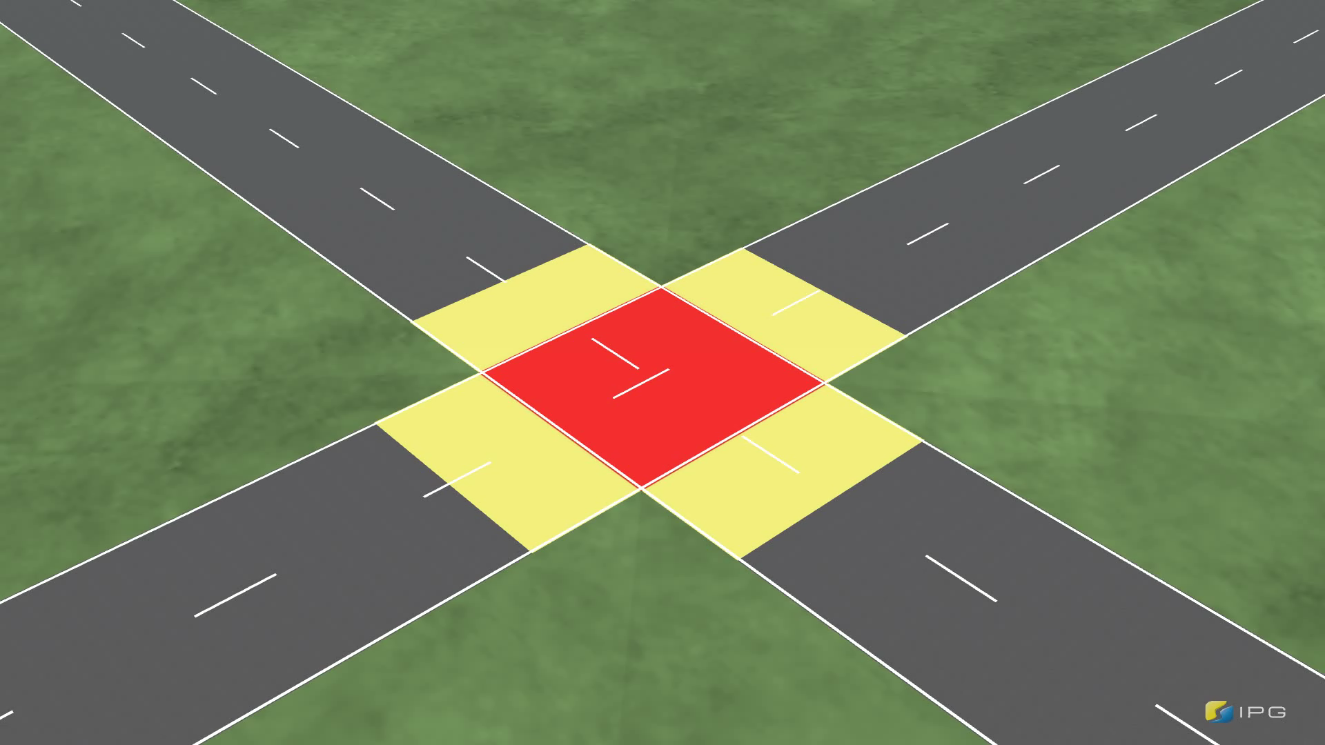
Case study setup
Notes:
MPC Testing: Three cars with different reference speed and starting distance to the intersection, no turns
Desired crossing sequence 1,2,3 →The search over possible crossing sequences (one of the motivations to formulate the problem as an efficient QP) is skipped
Without a controller, car 1 and 2 would collide (see video https://www.dropbox.com/s/ja5i1yqadpmilyf/crashSide60Hz.avi?dl=0)
MPC takes control over the vehicle when it enters the control region (60m from intersection)
Red: critial region (15mx15m) no collision!

Slide 11

Case study setup
Notes:
MPC Testing: Three cars with different reference speed and starting distance to the intersection, no turns
Desired crossing sequence 1,2,3 →The search over possible crossing sequences (one of the motivations to formulate the problem as an efficient QP) is skipped
Without a controller, car 1 and 2 would collide (see video https://www.dropbox.com/s/ja5i1yqadpmilyf/crashSide60Hz.avi?dl=0)
MPC takes control over the vehicle when it enters the control region (60m from intersection)
Red: critial region (15mx15m) no collision!

Slide 12
MPC in case study
Notes:
Initial optimization horizon: 135m (60m + 15m + 60m), sampling interval 1m
Car 1 accelerates when it comes closer to the intersection
Car 2 decelerates to avoid a collision with car 1
Car 3 slows down to avoid a collision with car 2
Smooth velocity
In position plot: it can be seen, that the MPC efficently prohibts collisions (upward triangle: vehicle is entering the intersection, downward triangle: leaving the intersection), no vertical allignment among the triangles → no collisions
Last plot: computation time. Decreased by using a QP solver instead of a SOCP solver.
Low computation time in general. Increasing trend up to the point where all cars are in the control area (18th second)
Afterwards, decreasing trend because the prediction horizon is shrinking for all vehicles

Slide 13
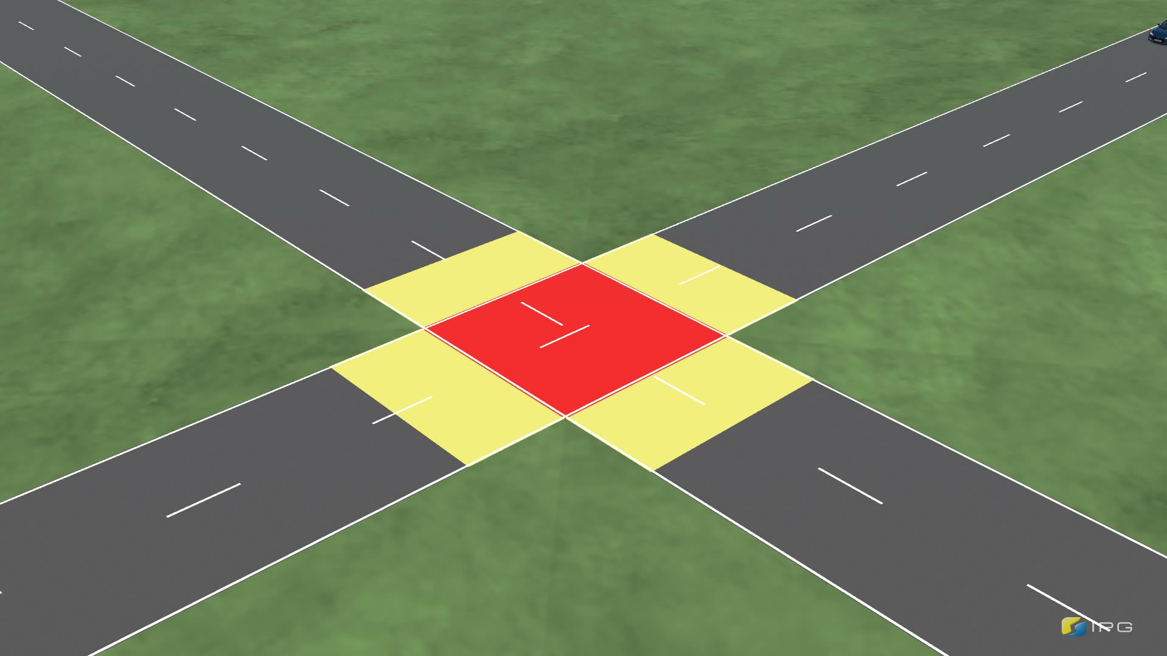
MPC in case study
Notes:
Video shows again that the controller prevents the collision
https://www.dropbox.com/s/necg4i3d16m5x4s/side60hz.avi?dl=0

Slide 14
MPC in case study
Notes:
Video shows again that the controller prevents the collision
https://www.dropbox.com/s/necg4i3d16m5x4s/side60hz.avi?dl=0

Slide 15
Conclusions
Centralized MPC for optimal control of the cars in the control area
Convex quadratic program
Tested for advanced vehicle model in CarMaker
The algorithm successfully avoids collisions in the case study example
Future work:
More advanced validation
Inclusion of sensor noise
Extension of the simulation environment
Extension of the road construction: Include turning in the crossing
Robustness

